Slide 1
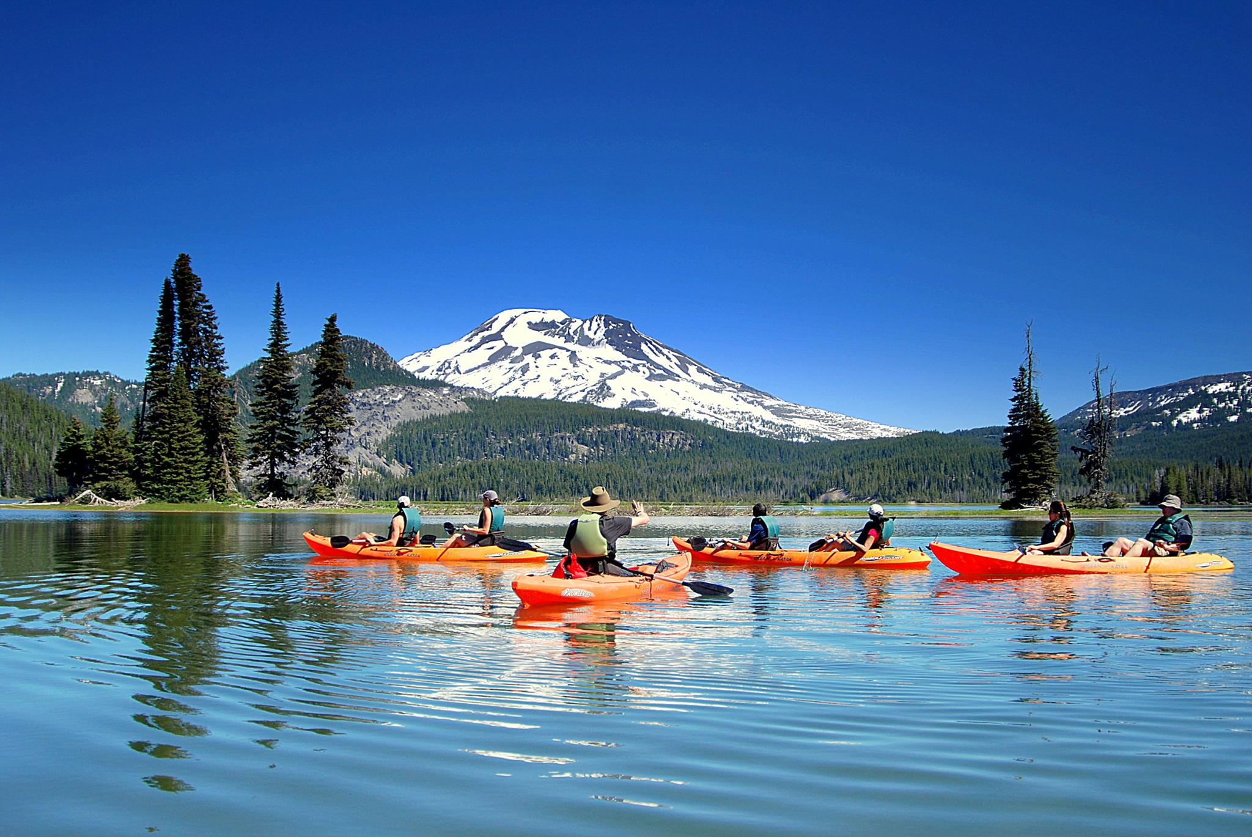
Paddle the glassy waters of the Cascades Lakes on a Kayak
Kayak Tours

Slide 2
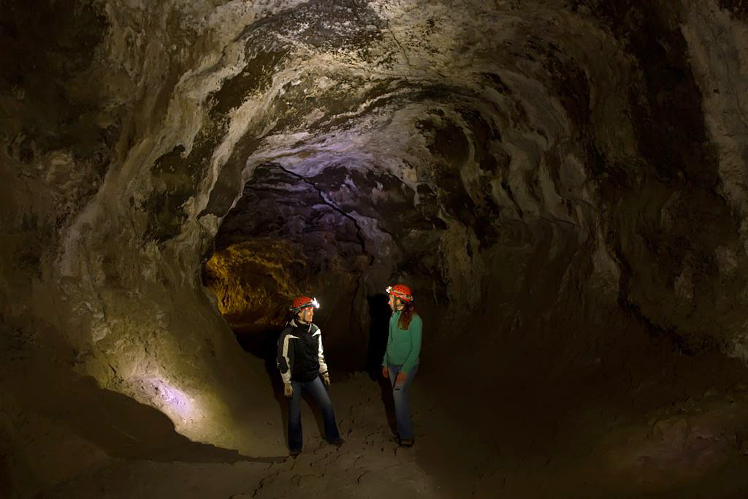
Explore the cool lava caves and discover what lives and grows inside
Cave Tours

Slide 3
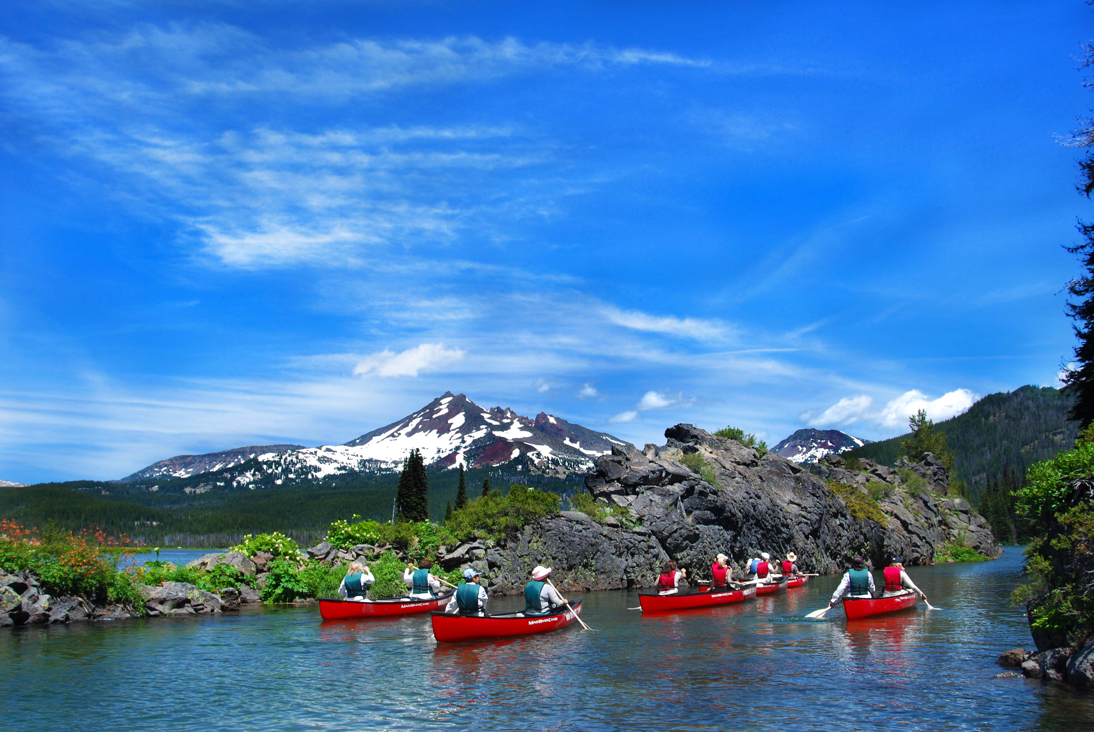
Enjoy the scenic vistas of the Cascade Range on a Canoe
Canoe Tours

Slide 4
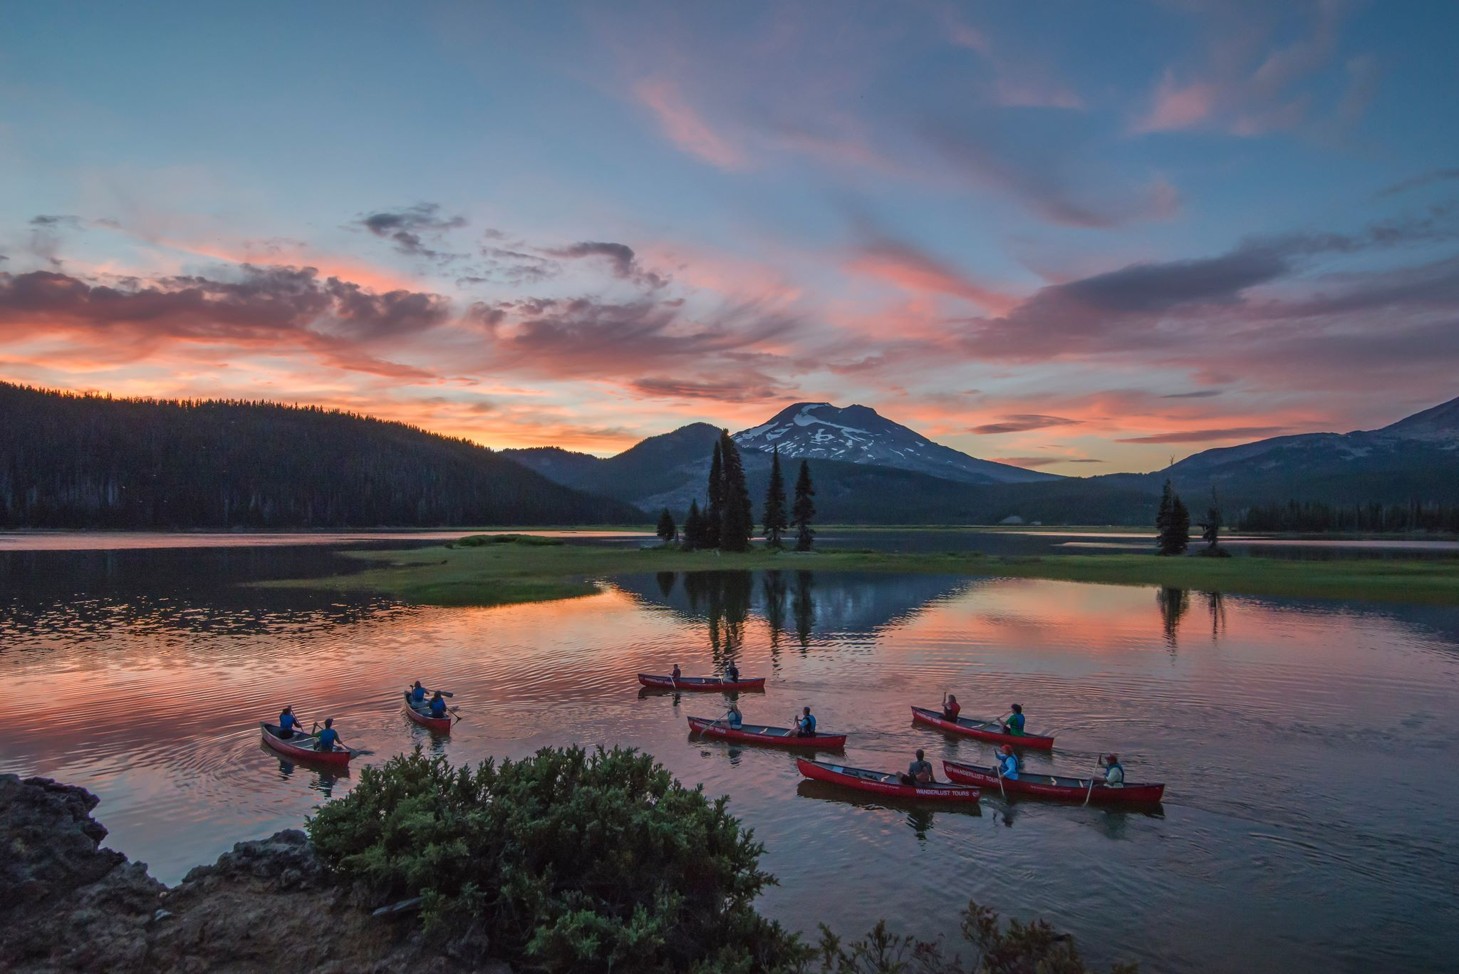
Open your senses by canoeing under the moonlight or starlight
Moonlight Tours

Slide 5
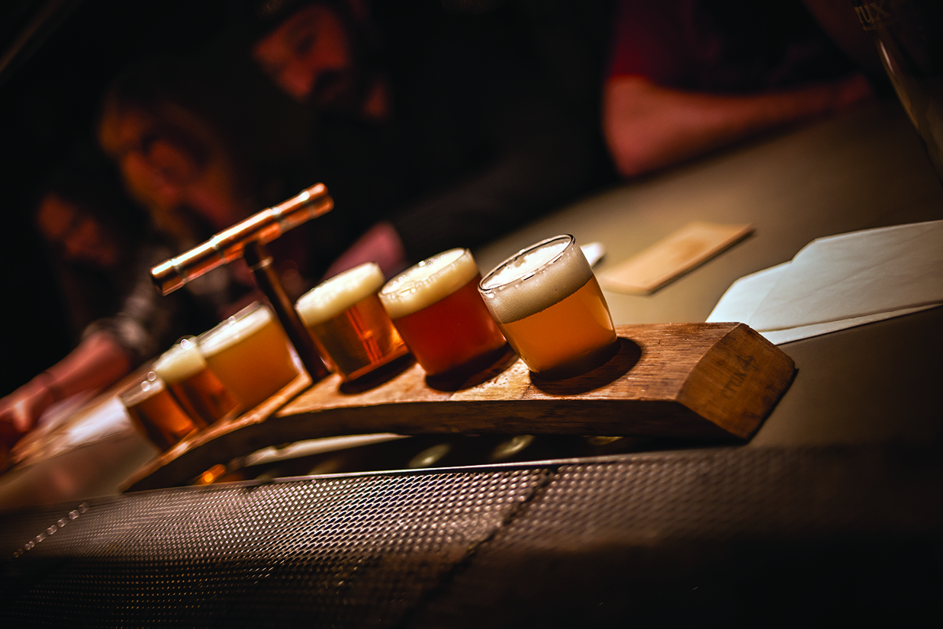
Grab a taste of Bend’s ale culture on the Bend Brew Bus
Bend Brew Bus

Slide 6
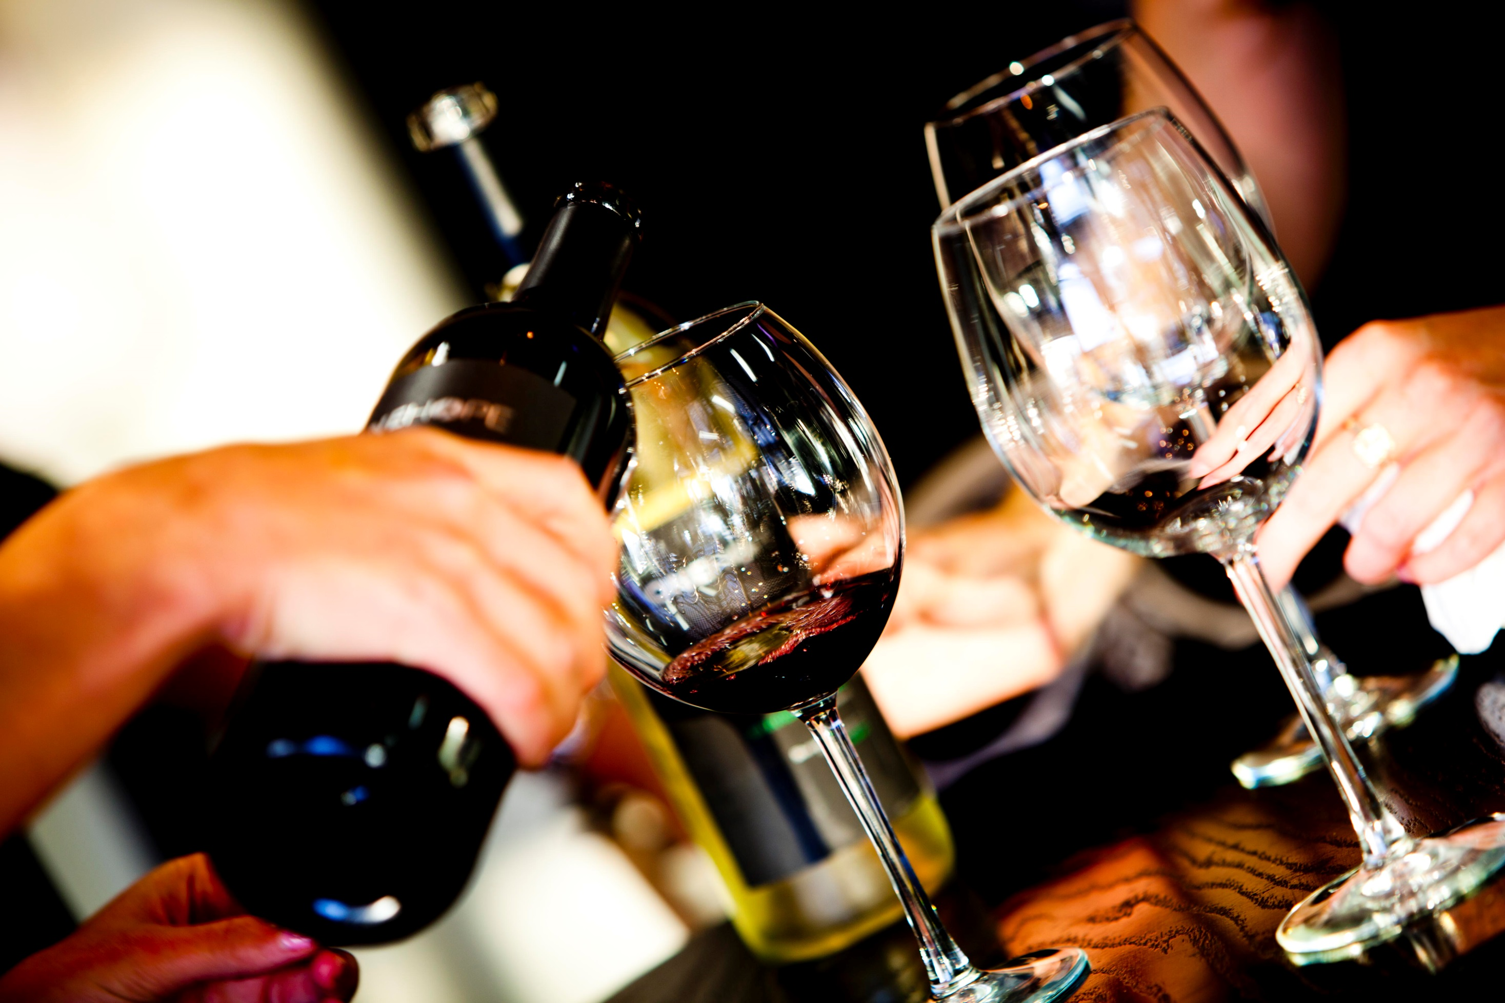
Get a behind-the-scenes look at a brewery, winery, cidery and distillery
The Local Pour

Slide 7
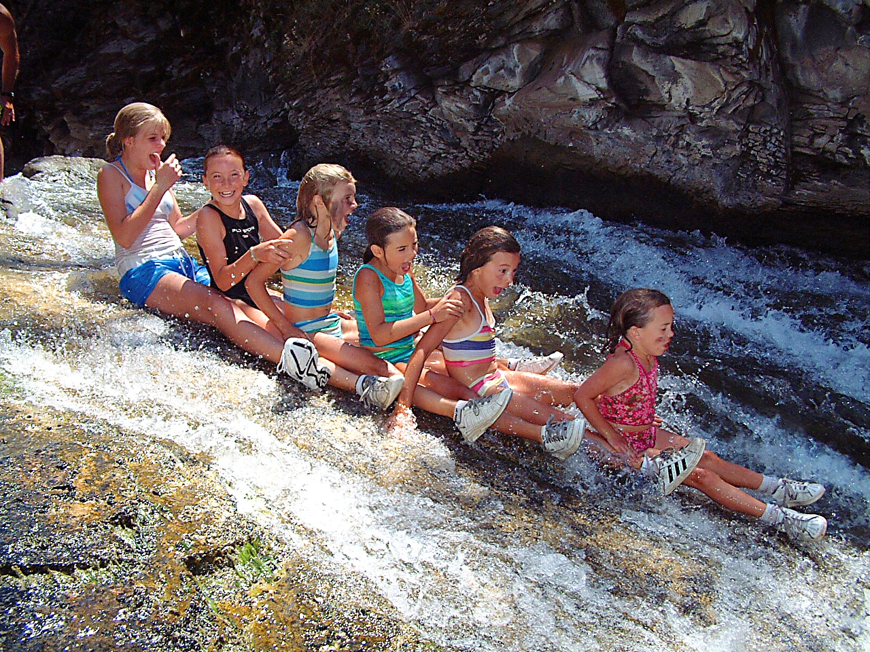
Get wet and wild with this waterfall mountain biking adventure
The Paulina Plunge

Slide 8
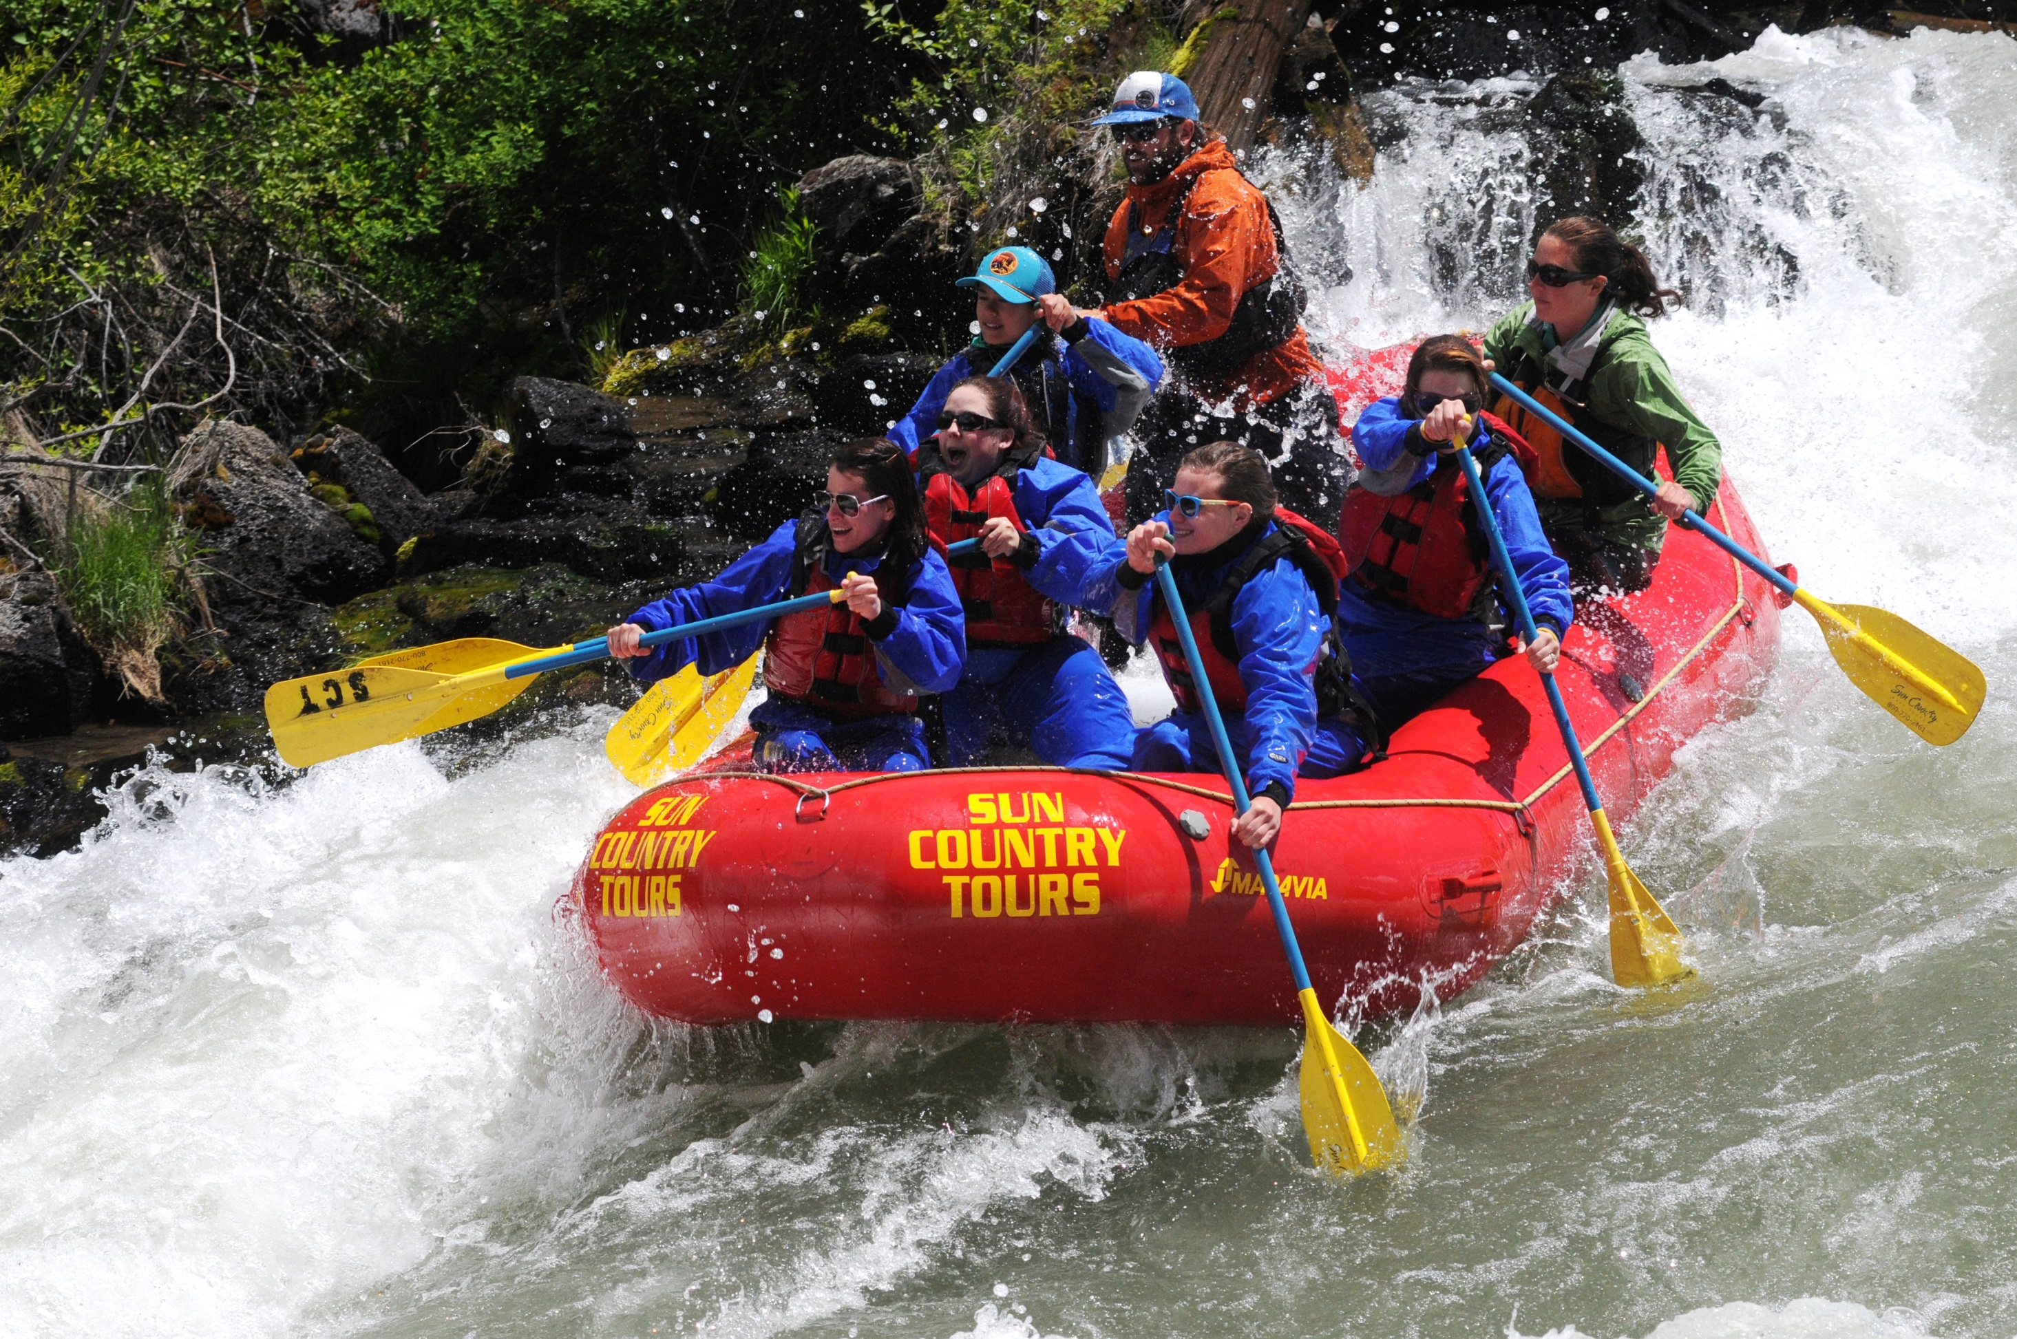
Beat the heat with a whitewater adventure on the Deschutes
The Big Eddy

Slide 9
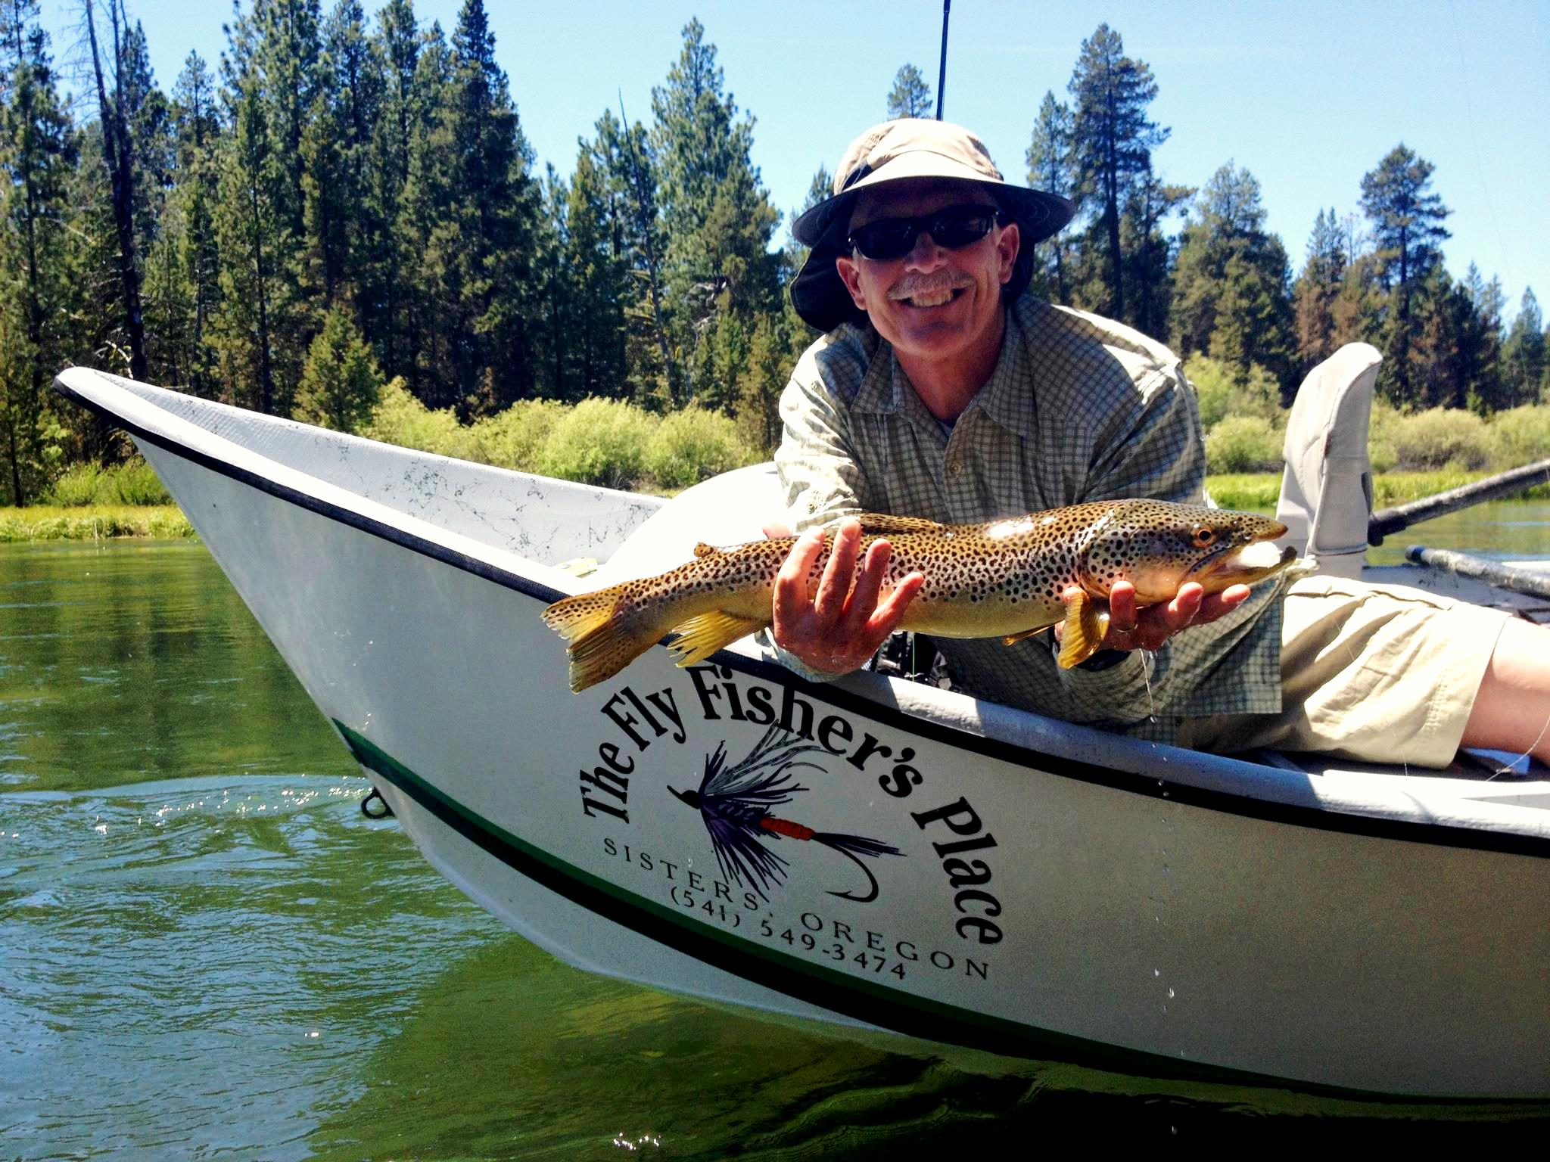
Schedule a customized fly fishing trip at your favorite river or lake
The Fly Fisher’s Place

Slide 10
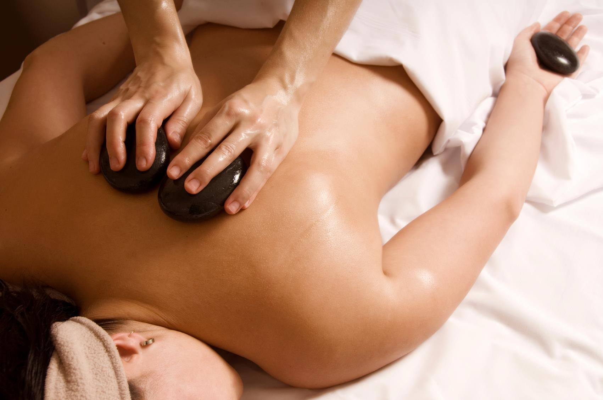
Relax, rejuvenate and recharge with a massage at the Spa
The Spa

Slide 11
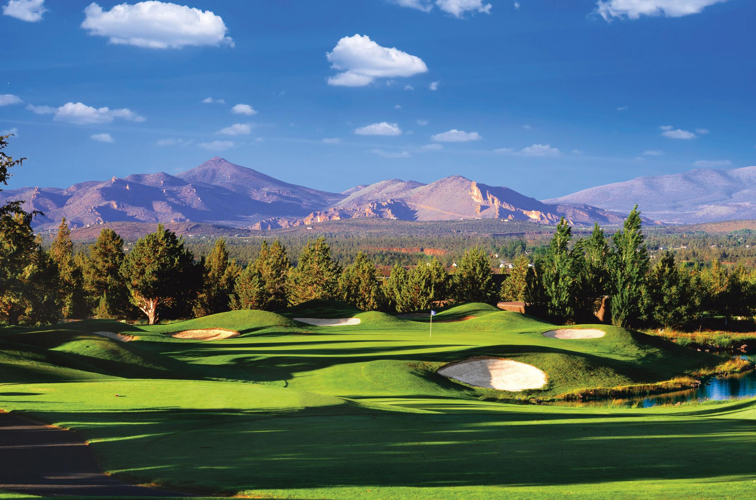
Enjoy a day of golf at the Resort, Ridge or Challenge Course
Golf at Eagle Crest

Slide 12
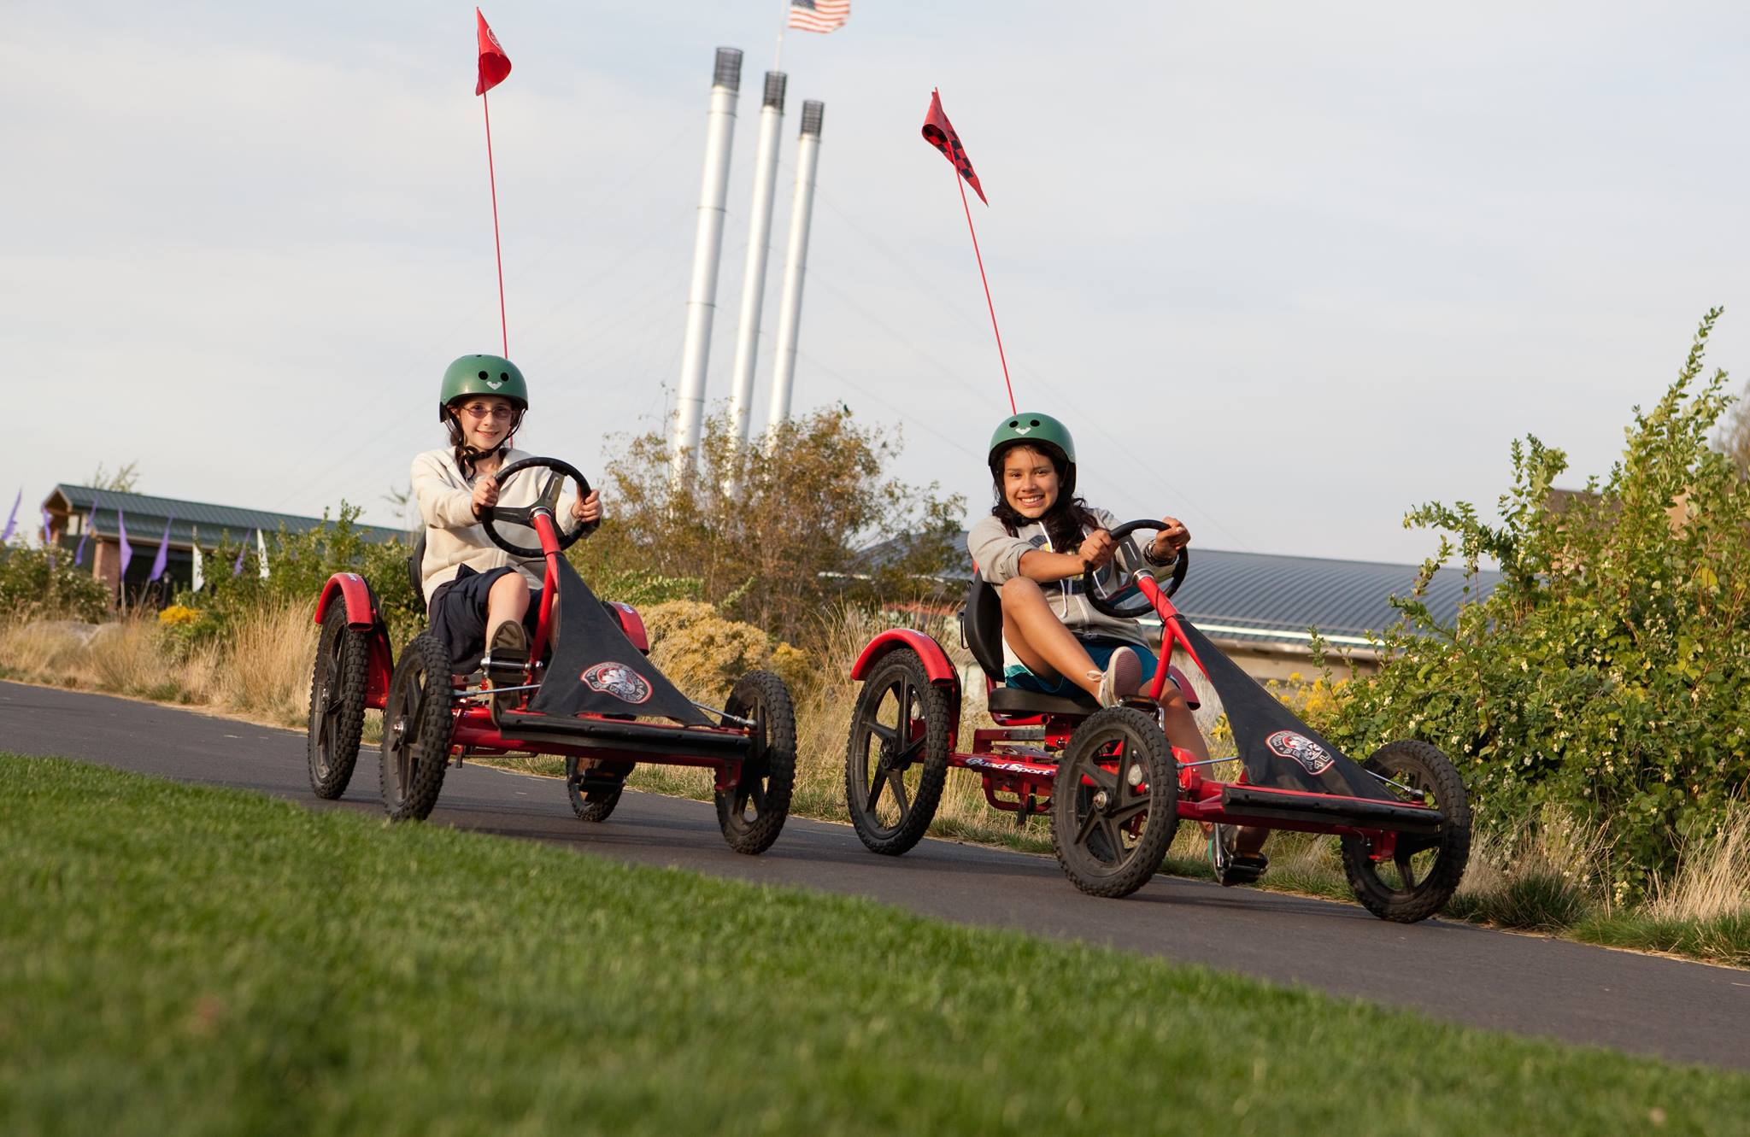
Explore Eagle Crest in style on a unique bicycle from the Resort Sports Center
Wheel Fun Rentals

